Slide 1
Week 4 – Algorithms
Microsoft Interview Coaching Program

Slide 2
Agenda
Announcements
TEBOW IT review for last week’s homework assignment (3 Sum)
Sorting and Searching Overview
Recursion
Classroom problem: House Robbery
Homework submission guidelines
Homework problem

Slide 3
Announcements
Continue to @mention another student for code reviews
Midpoint checkup
Interview time management tips
Notes:
Having a structured approach to a problem and not finishing is much better than having a scattered thought process
Equivalence class testing, optimizing, test cases, walk through, all give you better chance of writing correct code
Don’t spend too much time on optimize, as long as you feel like you can code a good solution
Another clarifying question: are there space/time constraints?
W – pictures and short text blurbs could be sufficient
Will try to choose questions that are typically used in interviews, don’t’ require as much writing
Our job is to change the culture of interviewing

Slide 4
TEBOW IT – 3SUM
Given an array S of n integers, are there elements a, b, c in S such that a + b + c = 0? Find all unique triplets in the array which gives the sum of zero.
Note: The solution set must not contain duplicate triplets.
For example, given array S = [-1, 0, 1, 2, -1, -4],
A solution set is:
[ [-1, 0, 1], [-1, -1, 2] ]
Notes:
How long did it take you to TEBOW IT?
What was the hardest part?

Slide 5
T - Talk
What is the input?
Array of integers
Does it contain duplicate values?
Yes, the array may have duplicate values
Is the array sorted?
No
Do we know any extra information about the type of integers in array? Like are they all non-negative integers etc.
Array can contain positive, negative and 0 as elements.
What is returned? The indices of the integers or the actual integers themselves?
Actual integer elements
How are they returned? (Discuss options with interviewer, instead of just asking him/her)
As an array of array / as a list of lists / as a list of tuples / a custom class object
In the output array, should the elements be sorted?
Sort order of output elements does not matter.
How to handle bad inputs? (Discuss options with interviewer, instead of just asking him/her)
Return null / throw an exception
What to return when there is no pair that adds up to the target? (Discuss options with interviewer, instead of just asking him/her)
null
Notes:
Result containing two elements can be returned in multiple ways: as an array, a list, a tuple or a custom class object. For the purposes of this question, let’s assume an int array is retured (hence the bold)

Slide 6
E - Examples
Sample Input | Class | Out
Arr: Null | Null input array | Throw an exception
Arr: [] / [1,2] / [4] | Empty array or array size is less than 3 | Throw an exception
Arr: [10, 10, 10] | Array with no solution | Empty list
Arr: [-1, 0, 1, 3, -4] | Array with solution | [[-4,1,3],[-1,0,1]]
Arr: [-1, 0, 1, 2, -1, -4] | Array with solution. With possible duplicate results. | [[-1,-1,2],[-1,0,1]] ([-1, 0, 1] can appear twice, but is eliminated)
Arr: [-6, 2, 3, 3] | Array with solution. With some results containing duplicate elements. | [[-6, 3, 3]] 3 appears twice in the result, but that’s acceptable.

Slide 7
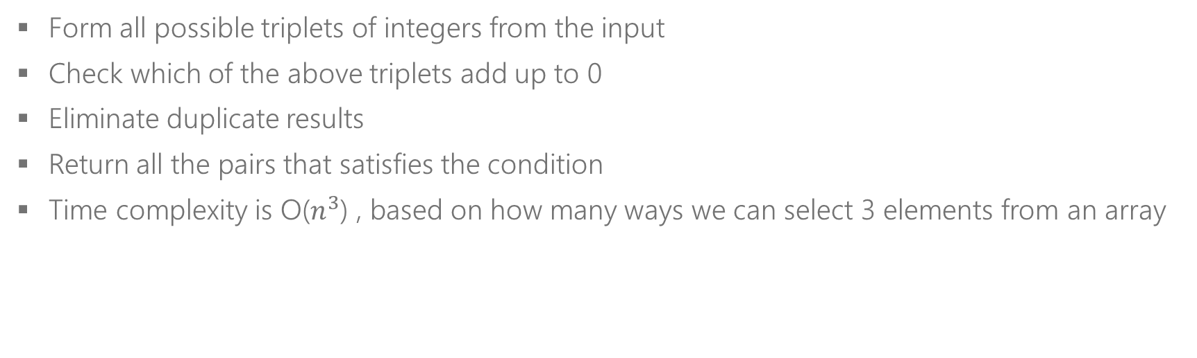
B – Brute Force
Form all possible triplets of integers from the input
Check which of the above triplets add up to 0
Eliminate duplicate results
Return all the pairs that satisfies the condition
Time complexity is O($n^{3}$) , based on how many ways we can select 3 elements from an array

Slide 8

O - Optimize
Can we do better than O($n^{3}$)?
We already know how to get 2Sum (which takes array and target as inputs) that runs in O(n). Can we extend it to find 3Sum?

Slide 9
O - Optimize
How can we extend 2Sum?
2Sum takes array and target as inputs
Iterate over the input array and for each element, calculate 2Sum, with negative of current element as the target and the remaining array as the input array to 2Sum?
a + b + c = 0 => -a = b + c
for each iteration, target = -a = b+c

Slide 10
O - Optimize
List<Tuple<int, int>> GetTwoSum(int[] arr, int startindex, int target)
Iteration: 0
Current element =
Target = -(current element) =
Call GetTwoSum()
Iteration: 1
Current element =
Target = -(current element) =
Call GetTwoSum()
Iteration: 2
Current element =
Target = -(current element) =
Call GetTwoSum()
Iteration: 3
Current element =
Target = -(current element) =
Call GetTwoSum()
Iteration: 4
Current element =
Target = -(current element) =
Call GetTwoSum()
Example
0
1
2
3
4
-5
3
1
4
2
Notes:
This slide is used for writing the contents as we discuss with the students.
That’s why the equations are all empty.
The next slide has them filled up.

Slide 11
O - Optimize
List<Tuple<int, int>> GetTwoSum(int[] arr, int startindex, int target)
Iteration: 0
Current element = -5
Target = -(current element) = 5
Call GetTwoSum(arr, 1, 5). Returns { [3, 2], [1, 4] }. 3Sum returns { [-5, 3, 2], [-5, 1, 4] }
Iteration: 1
Current element = 3
Target = -(current element) = -3
Call GetTwoSum(arr, 2, -3)
Iteration: 2
Current element = 1
Target = -(current element) = -1
Call GetTwoSum(arr, 3, -1)
Iteration: 3
Current element = 4
Target = -(current element) = -4
Call GetTwoSum(arr, 4, -4)
Iteration: 4
Current element = 2
Target = -(current element) = -2
Call GetTwoSum(arr, 5, -2), of course this iteration does not return any thing as startIndex is out of bounds.
Example
0
1
2
3
4
-5
3
1
4
2
Notes:
Pointers from beginning and end
-2: I need to add 16 to get to target of 14, can’t do it
3: I need to add 11 to get to target of 14, can’t do it
4:, need to add 10 to get to target of 14, yup!

Slide 12
O - Optimize
List<Tuple<int, int>> GetTwoSum(int[] arr, int startindex, int target)
Iteration: 0
Current element = -1
Target = -(current element) = 1
Call GetTwoSum(arr, 1, 1). 2Sum Returns { [0, 1] }. So far we have { [-1, 0, 1] }
Iteration: 1
Current element = 0
Target = -(current element) = 0
Call GetTwoSum(arr, 2, -3). 2Sum Returns { [-1, 1] }. We again get { [-1, 0, 1] }
Iteration: 2
Current element = 1
Target = -(current element) = -1
Call GetTwoSum(arr, 3, -1)
Iteration: 3
Current element = 5
Target = -(current element) = -5
Call GetTwoSum(arr, 4, -5)
Iteration: 4
Current element = 2
Target = -(current element) = -2
Call GetTwoSum(arr, 5, -2), of course this iteration does not return any thing as startIndex is out of bounds.
Wait!
Let’s consider this example
Which has duplicate values
0
1
2
3
4
-1
0
1
5
-1
Notes:
Pointers from beginning and end
-2: I need to add 16 to get to target of 14, can’t do it
3: I need to add 11 to get to target of 14, can’t do it
4:, need to add 10 to get to target of 14, yup!

Slide 13
O - Optimize
List<Tuple<int, int>> GetTwoSum(int[] arr, int startindex, int target)
Iteration: 0
Current element = -1
Target = -(current element) = 1
Call GetTwoSum(arr, 1, 1). 2Sum Returns { [0, 1] }. So far we have { [-1, 0, 1] }
Iteration: 1 (SKIPPED)
Current element = -1
Target = -(current element) = 1
Call GetTwoSum(arr, 2, 1). 2Sum Returns { [0, 1] }. We again get { [-1, 0, 1] }
Iteration: 2
Current element = 0
Target = -(current element) = 0
Call GetTwoSum(arr, 3, 0)
Iteration: 3
Current element = 1
Target = -(current element) = -1
Call GetTwoSum(arr, 4, -1)
Iteration: 4
Current element = 5
Target = -(current element) = -5
Call GetTwoSum(arr, 5, -5), of course this iteration does not return any thing as startIndex is out of bounds.
Would sorting the array help?
Yes! It helps in skipping the duplicate
elements while we iterate
0
1
2
3
4
-1
-1
0
1
5
Notes:
Pointers from beginning and end
-2: I need to add 16 to get to target of 14, can’t do it
3: I need to add 11 to get to target of 14, can’t do it
4:, need to add 10 to get to target of 14, yup!

Slide 14
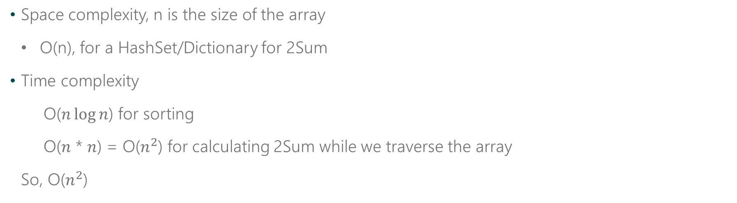
O - Optimize
Space complexity, n is the size of the array
O(n), for a HashSet/Dictionary for 2Sum
Time complexity
O($n\log{n}$) for sorting
O($n$ * $n$) = O($n^{2}$) for calculating 2Sum while we traverse the array
So, O($n^{2}$)

Slide 15
W – Walk Through
Input Validation
If the input array is null or has less than three elements, return throw an exception
Setup
Iterate over array
Return result
Create and initialize the List of list of integers (let’s call it L) that stores and returns the results.
For each element, calculate the 2Sum target value and call 2Sum with appropriate arguments
Return all the values we have collected in L so far.
Sort the array(that helps in bringing duplicate elements together)
Make sure to skip over the duplicate elements.
For each result returned by 2Sum, append this to L.
Implement 2Sum
Make sure to return all possible results, instead of the first possible result.

Slide 16
I – Implement

Slide 17
public IList<IList<int>> ThreeSum(int[] nums)
{
if(nums == null)
throw new ArgumentNullException("Input array cannot be null!");
if(nums.Length < 3)
throw new ArgumentException("Input array cannot have size less than 3!");
IList<IList<int>> triplets = new List<IList<int>>();
Array.Sort(nums);
for(int i=0; i<nums.Length - 2; i++)
{
if (i > 0 && nums[i] == nums[i-1])
continue;
List<Tuple<int, int>> result = TwoSum(nums, i+1, -nums[i]);
foreach(var couple in result)
triplets.Add(new List<int>(){nums[i], couple.Item1, couple.Item2});
}
return triplets;
}

Slide 18
private List<Tuple<int, int>> TwoSum(int[] nums, int startIndex, int target)
{
List<Tuple<int, int>> result = new List<Tuple<int, int>>();
HashSet<int> map = new HashSet<int>();
for(int i=startIndex; i<nums.Length; i++)
{
int lookup = target - nums[i];
if(map.Contains(lookup))
{
var res = new Tuple<int, int>(lookup, nums[i]);
if(!result.Contains(res))
result.Add(res)
}
else
{
map.Add(nums[i]);
}
}
return result;
}

Slide 19
T – Test/DEBUG
Sample Input | Class | Out
Arr: Null | Null input array | Throw an exception
Arr: [] / [1,2] / [4] | Empty array or array size is less than 3 | Throw an exception
Arr: [10, 10, 10] | Array with no solution | Empty list
Arr: [-1, 0, 1, 3, -4] | Array with solution | [[-4,1,3],[-1,0,1]]
Arr: [-1, 0, 1, 2, -1, -4] | Array with solution. With possible duplicate results. | [[-1,-1,2],[-1,0,1]] ([-1, 0, 1] can appear twice, but is eliminated)
Arr: [-6, 2, 3, 3] | Array with solution. With some results containing duplicate elements. | [[-6, 3, 3]] 3 appears twice in the result, but that’s acceptable.
Notes:
Do you notice how this slide is always the same as the ‘examples’ slide? Use it to debug your code

Slide 20
Searching and Sorting
The Bread and Butter of Algorithms…
Be familiar with the runtime and implementation of the most popular sorting/searching algorithms
Many sorting/searching problems are variations on the most well-known algorithms
Even if a problem isn’t a direct searching or sorting problem, the optimized solution may rely upon some form of searching/sorting
Don’t reinvent the wheel, ask your interviewer if you’re allowed to use the built-in functions when applicable! (String.Contains, String.IndexOf, Array.Sort…)

Slide 21
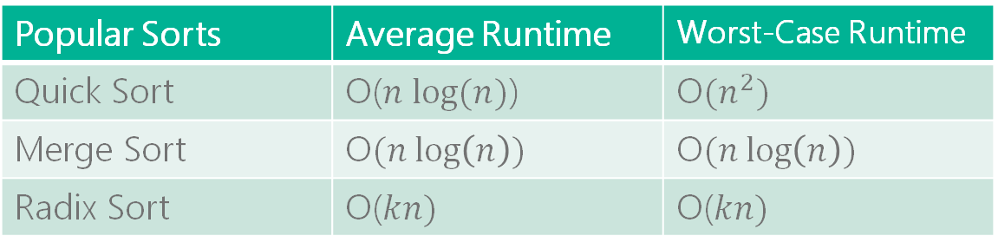
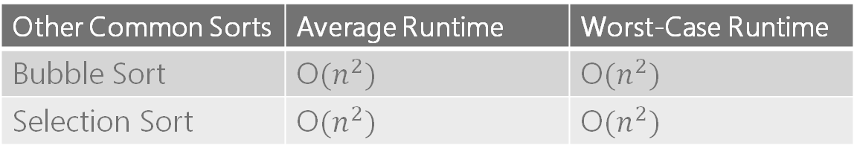
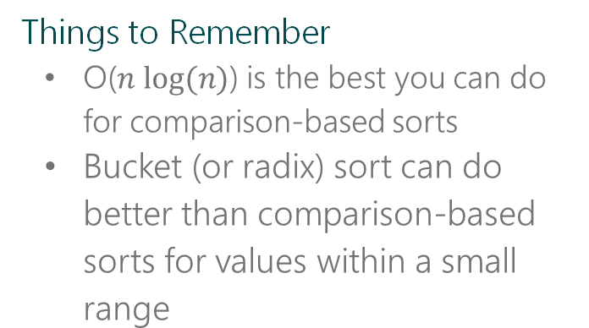
Sorting
Things to Remember
O($n log⁡(n)$) is the best you can do for comparison-based sorts
Bucket (or radix) sort can do better than comparison-based sorts for values within a small range
Popular Sorts | Average Runtime | Worst-Case Runtime
Quick Sort | O($n log⁡(n)$) | O$(n^{2})$
Merge Sort | O$(n\log\left(n\right))$ | O$(n\log\left(n\right))$
Radix Sort | O($kn)$ | O($kn)$
Other Common Sorts | Average Runtime | Worst-Case Runtime
Bubble Sort | O$(n^{2})$ | O$(n^{2})$
Selection Sort | O$(n^{2})$ | O$(n^{2})$
Notes:
Most sorting interview questions will focus on the top set of sorts
Quick Sort: can be O(n^2) if there was a bad choice of pivot
Radix sort: O(kn) where k is the number of passes of the sorting algorithm

Slide 22
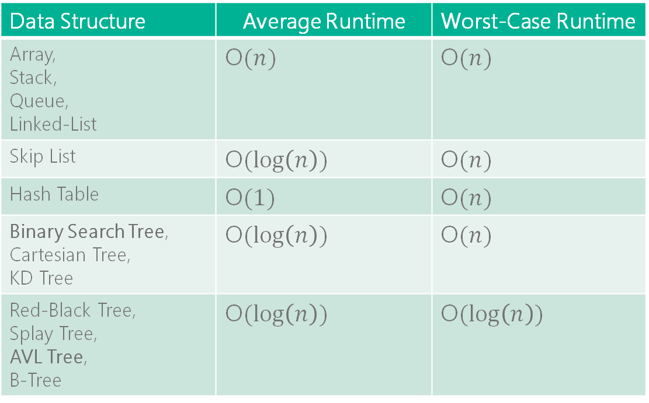
Searching
Data Structure | Average Runtime | Worst-Case Runtime
Array, Stack, Queue, Linked-List | O$(n)$ | O$(n)$
Skip List | O$(\log\left(n\right))$ | O$(n)$
Hash Table | O$(1)$ | O$(n)$
Binary Search Tree, Cartesian Tree, KD Tree | O$(\log\left(n\right))$ | O$(n)$
Red-Black Tree, Splay Tree, AVL Tree, B-Tree | O$(\log\left(n\right))$ | O$(\log\left(n\right))$
Popular Algorithms
Sorted arrays: Binary Search
Graphs: BFS + DFS
Strings: Rapin-Karp, Knuth-Morris-Pratt (KMP), Boyer-Moore
Notes:
String searching algorithms – good to know (particularly Rapin-Karp), but not extremely common in interviews
Binary Search Tree – search can be O(n) if nodes were inserted in a bad order (for example, if the value of each successive node was larger than the node before it) because it effectively turns into a linked list

Slide 23
Recursion
Recognizing Recursion
Solution can be built out of the solution to subproblems
Common phrasing:
“… compute/list the first n”
“Implement a method to compute all…”
Common Mistakes
Missing/incorrect base case(s)
Not discussing recursion vs. iteration trade-offs with your interviewer
Common Recursive Problems
Fibonacci
Towers of Hanoi
Generate Parentheses
Stack of Boxes
Three Pillars
Base Case
Work towards Base Case
Recursive Call

Slide 24
Iteration vs. Recursion
A Complexity vs. Space Trade-Off
Recursion is typically less space efficient
A new layer is added to the stack for each recursive call, so an algorithm that recurses to depth n will use at least O(n) of memory
All recursive algorithms can be implemented iteratively, but the code may be much more complex
Tip: If you’re considering solving a problem with recursion, ask yourself how hard it is to implement iteratively and discuss trade-offs with your interviewer

Slide 25
House Robber
You are a professional robber planning to rob houses along a street. Each house has a certain amount of money stashed, the only constraint stopping you from robbing each of them is that adjacent houses have security system connected and it will automatically contact the police if two adjacent houses were broken into on the same night.
Given a list of integers representing the amount of money of each house, determine the maximum amount of money you can rob tonight without alerting the police.

Slide 26
T - Talk
What is the input?
Array of integers
Can the input array contain negative integers or 0?
No negative integers, but a house may have 0 cash.
What is the output? Is it the maximum amount itself or the indices of the houses making up the maximum amount … ?
Integer representing the maximum amount that can be stolen
What if the input is null or empty array?
Throw exception or return 0 respectively.
Could the result amount be more than the MAX_INT?
No.
Notes:
Ask them if they wanted to sort the array. Ideally we shouldn’t because that’s gonna mess up the order of the houses!

Slide 27
E - Examples
Sample Input | Class | Out
Null | Null array | Throw exception
[] | Empty array | 0
[10] | Array with single element | 10
[10, 20] | Array with two elements | Max of the two, 20
[10, 40, 30, 20] | Array with even number of elements | 60
[10, 20, 60] | Array with odd number of elements | 70
[10, 100, 20] | Fewer houses resulting in max sum | 100
[0, 0, 0, 0] | Array with all houses having no cash | 0

Slide 28
B – Brute Force
Robber can either go with all odd houses OR all even houses, which ever option gives more cash
This gives us a O(n) solution
But wait, what if this is the input …
Even houses: 8 + 1 = 9
Odd houses: 4+ 9 = 13
But [0] + [3] = 8 + 9 = 17, still satisfies the condition of non-adjacency
8
4
1
9

Slide 29
B – Brute Force
From the set of houses, form all possible subsets.
From above, check which satisfy the non-adjacency constraints.
Of these calculate the total sum.
Return the maximum sum

Slide 30

B – Brute Force
Time complexity is O($2^{n}$)
5
4
1
3
8
12
98
Include
or
exclude
Include
or
exclude
Include
or
exclude
Include
or
exclude
Include
or
exclude
Include
or
exclude
Include
or
exclude
2 X 2 X 2 X 2 X 2 X 2 X 2

Slide 31

O – Optimize
Can we do better than O($2^{n}$)?
Would sorting the array help?
No, we would mix up the positions of the houses by sorting

Slide 32
O - Optimize
let’s consider this input:
8
4
1
9
3
7
2
Max sum = Max sum of [1-6]
Excluded
Included
8
4
1
9
3
7
2
Max sum = 8 + Max sum of [2-6]
0
1
2
3
4
5
6

Slide 33
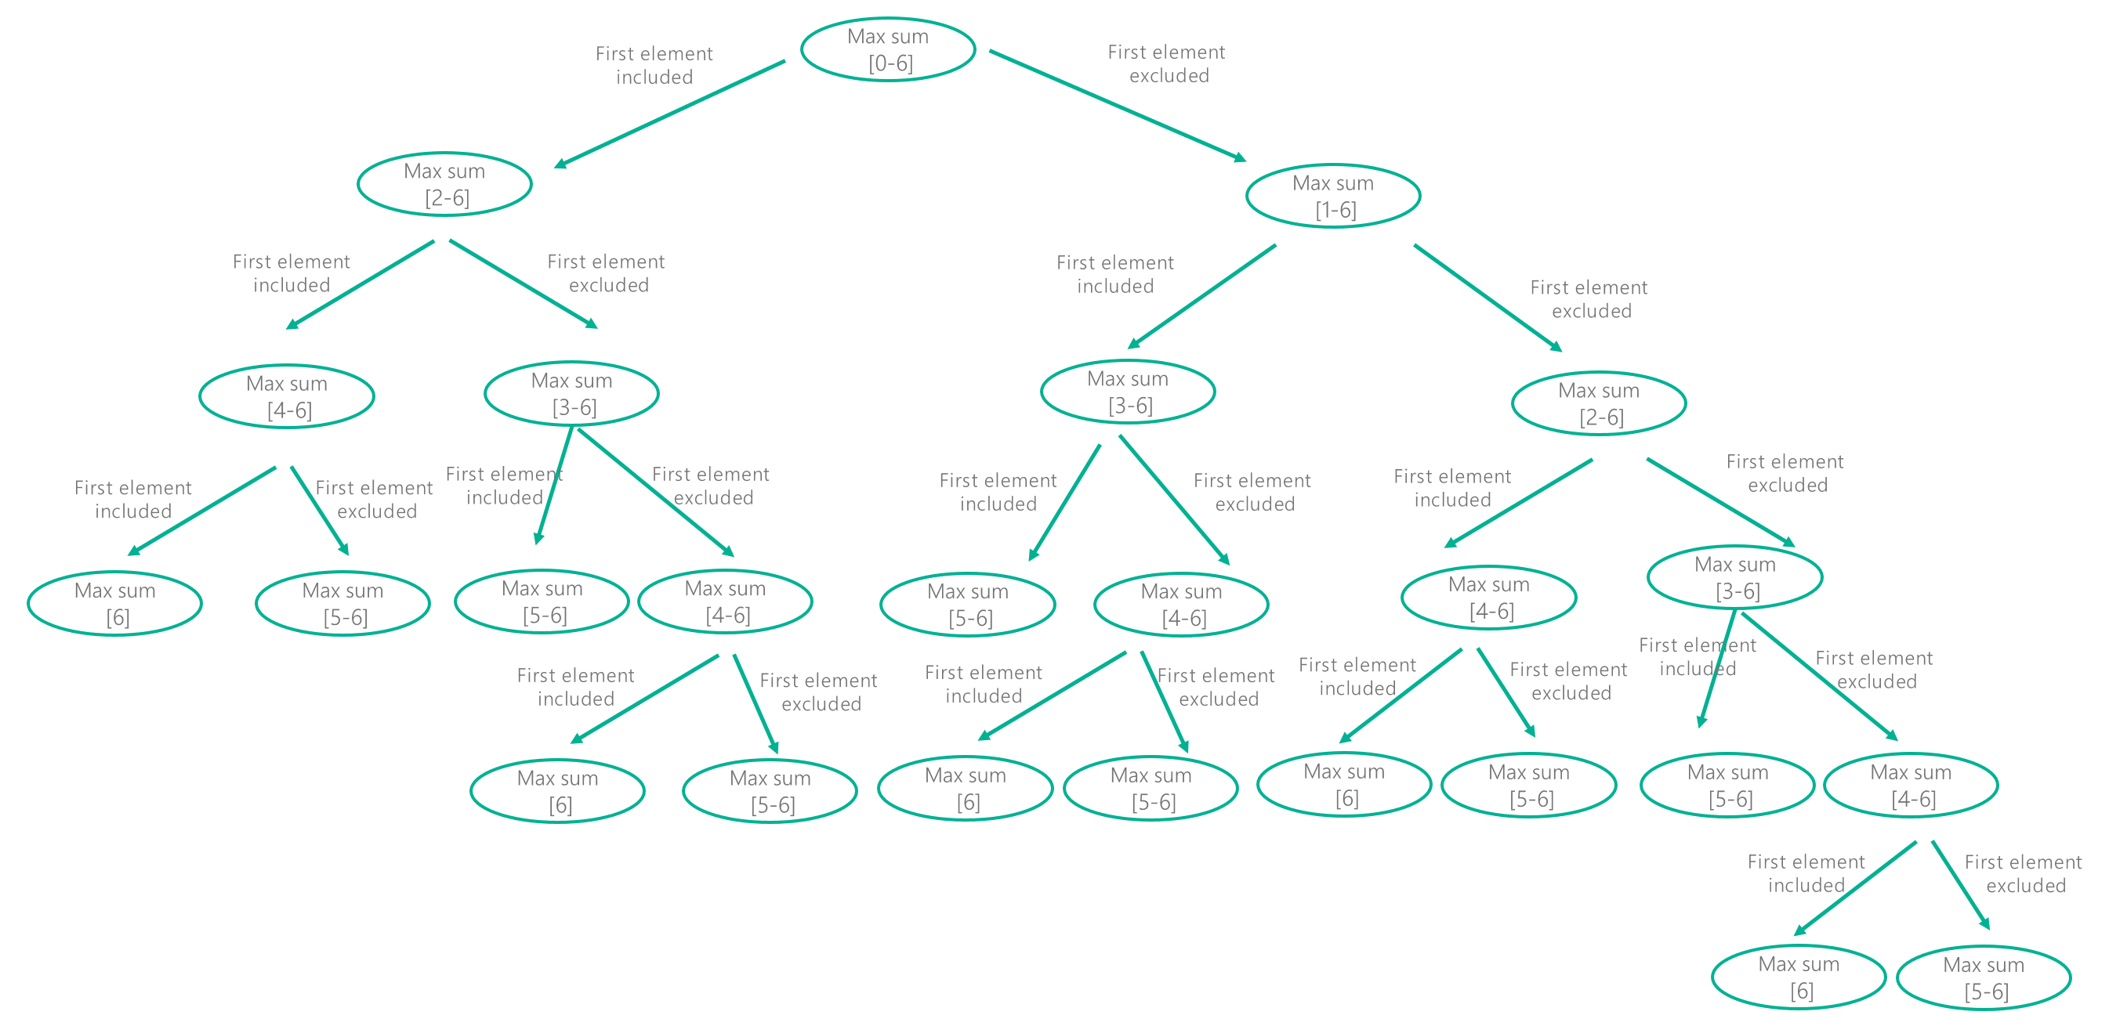
8
4
1
9
3
7
2
0
1
2
3
4
5
6
Notes:
The total number of nodes in the tree represents the runtime, as each call does O(1) work outside of it’s recursive calls. Until hitting the base cases, each node has two children, and each of those two children have two children and so on. If you do this n times (i.e. go down n levels), you’ll have done roughly O(2^n) work.
Note: Because the bottom levels of the tree aren’t fully populated, the runtime of this algorithm is slightly better than O(2^n). However, as Big O is used to describe an upper-bound, O(2^n) is still an accurate description for the exponential runtime of this algorithm.

Slide 34

O - Optimize
Time complexity
O($2^{n}$) nodes doing constant work, so O($2^{n}$)

Slide 35
W – Walk Through

Slide 36
Create CALLING method
Create RECURSIVE method
Create BASE conditions
Create a method that takes the input array and returns the output value. Let’s call it CALLING method
Create PROCESSING code and RECURSIVE CALLS
Consider including the first element, calculate it now through recursive call
Consider excluding the first element, calculate now through recursive call
Max of the above two values is the result for this subarray
Input validation
Check if the input array is null or empty and perform any other input validation
Call Recursive form Calling
Create a recursive method, that takes an input array and a start index, and returns the maximum value in the subarray starting from the start index
Call this RECURSIVE method from CALLING method to compute the maximum value for the entire array and return the result.
For an array with one element, the max is itself
For an array with two elements, the max is the bigger of the two elements

Slide 37
Best practice
In many cases, your recursive functions may need additional data structures or an argument that tracks the recursion level
Move the data structure or initialization code into a separate function
Notes:
Don’t feel constrained by the initial function signature

Slide 38
I – Implement

Slide 39
Calling method
public int Rob(int[] input)
{
if(input == null || input.Length == 0)
return 0;
return GetMaxMoney(input, 0);
}

Slide 40
RECURSIVE method
private int GetMaxMoney(int[] input, int startIndex)
{
int endIndex = input.Length -1;
// base case, one element
if (startIndex == endIndex)
return input[startIndex];
// base case, two elements
if (endIndex - startIndex == 1)
return Math.Max(input[startIndex], input[endIndex]);
int sumInclusive = 0, sumExclusive = 0;
sumExclusive = GetMaxMoney(input, startIndex + 1, store);
sumInclusive = input[startIndex] + GetMaxMoney(input, startIndex + 2, store);
return Math.Max(sumInclusive, sumExclusive);
}

Slide 41

Can we do better than O($2^{n}$)?

Slide 42
O - Optimize
Would a data structure help to optimize?
Starting Index | Result
[3-6] | x

Slide 43
8
4
1
9
3
7
2
0
1
2
3
4
5
6
Max sum
[0-6]
First element
excluded
First element
included
Max sum
[1-6]
Max sum
[2-6]
First element
excluded
First element
included
Max sum
[2-6]
Max sum
[3-6]
First element
included
First element
excluded
Starting Index | Result
6
5
4
3
2
1
0
Max sum
[3-6]
Max sum
[4-6]
First element
excluded
First element
included
Max sum
[4-6]
Max sum
[5-6]
First element
excluded
First element
included
Max sum
[5-6]
Max sum
[6]
Notes:
With this optimization, the recursion tree will look as follows (with black boxes representing cached calls that return immediately. If we count up, we see that we have about n levels with at most 2 nodes per level. This leaves us with roughly 2n nodes in the tree, indicating that the runtime of this algorithm is O(2n), which is equivalent to O(n)

Slide 44

O - Optimize
Space complexity, n is the size of the array
O(n), for the array
Time complexity
O(2$n$) recursive calls required, and each recursive call does constant work
So, O(2$n$), or simply, O(n)

Slide 45
Create CALLING method
Preparation
Create RECURSIVE method
Create and initialize the dictionary or array that stores results as we compute.
Create BASE conditions
Create a method that takes the input array and returns the output value. Let’s call it CALLING method
Create PROCESSING code and RECURSIVE CALLS
Consider including the first element, if we do not have the value calculated already, calculate it now through recursive call
Consider excluding the first element, if we do not have the value calculated already, calculate now through recursive call
Max of the above two values is the result for this subarray
Input validation
Check if the input array is null or empty and perform any other input validation
Call Recursive form Calling
Create a recursive method, that takes an input array, and a start index and the helper data structure and returns the maximum value in the subarray starting from the startIndex
Call this RECURSIVE method from CALLING method to compute the maximum value for the entire array and return the result.
Store this result for this recursive call in the helper data structure and return it to the calling method

Slide 46
Calling method
public int Rob(int[] input)
{
if(input == null || input.Length == 0)
return 0;
return GetMaxMoney(input, 0);
}

Slide 47
Calling method - optimized
public int Rob(int[] input)
{
if(input == null || input.Length == 0)
return 0;
int[] store = new int[input.Length];
for(int i =0; i< store.Length; i++)
store[i] = -1;
return GetMaxMoney(input, 0, store);
}

Slide 48
RECURSIVE method
private int GetMaxMoney(int[] input, int startIndex)
{
int endIndex = input.Length -1;
// base case, one element
if (startIndex == endIndex)
return input[startIndex];
// base case, two elements
if (endIndex - startIndex == 1)
return Math.Max(input[startIndex], input[endIndex]);
int sumInclusive = 0, sumExclusive = 0;
sumExclusive = GetMaxMoney(input, startIndex + 1, store);
sumInclusive = input[startIndex] + GetMaxMoney(input, startIndex + 2, store);
return Math.Max(sumInclusive, sumExclusive);
}

Slide 49
RECURSIVE method - optimized
private int GetMaxMoney(int[] input, int startIndex, int[] store)
{
if (store[startIndex] != -1)
return store[startIndex];
int endIndex = input.Length -1;
if (startIndex == endIndex)
return input[startIndex];
if (endIndex - startIndex == 1)
return Math.Max(input[startIndex], input[endIndex]);
int sumInclusive = 0, sumExclusive = 0;
sumInclusive = input[startIndex] + GetMaxMoney(input, startIndex + 2, store);
sumExclusive = GetMaxMoney(input, startIndex + 1, store);
int result = Math.Max(sumInclusive, sumExclusive);
if (store[startIndex] == -1)
store[startIndex] = result;
return result;
}

Slide 50
T - Test
Sample Input | Class | Out
Null | Null array | Throw exception
[] | Empty array | 0
[10] | Array with single element | 10
[10, 20] | Array with two elements | Max of the two, 20
[10, 40, 30, 20] | Array with even number of elements | 60
[10, 20, 60] | Array with odd number of elements | 70
[10, 100, 20] | Fewer houses resulting in max sum | 100
[0, 0, 0, 0] | Array with all houses having no cash | 0

Slide 51
Extra Practice
Generate Parentheses
Stack of Boxes
Search in Sorted/Rotated Array

Slide 52
Homework Problem
Word Break
Given an input string and a dictionary of words, find out if the input string can be segmented into a space-separated sequence of dictionary words.
For example, consider the following dictionary: { pear, salmon, foot, prints, footprints, leave, you, sun, girl, enjoy },
Examples:
Given the string “youenjoy”,
Output: True (The string can be segmented as “you enjoy”)
Input: “youleavefootprints”,
Output: True (The string can be segmented as “you leave footprints” or “you leave foot prints”)
Input:salmonenjoyapples
Output: False

